Slide 1
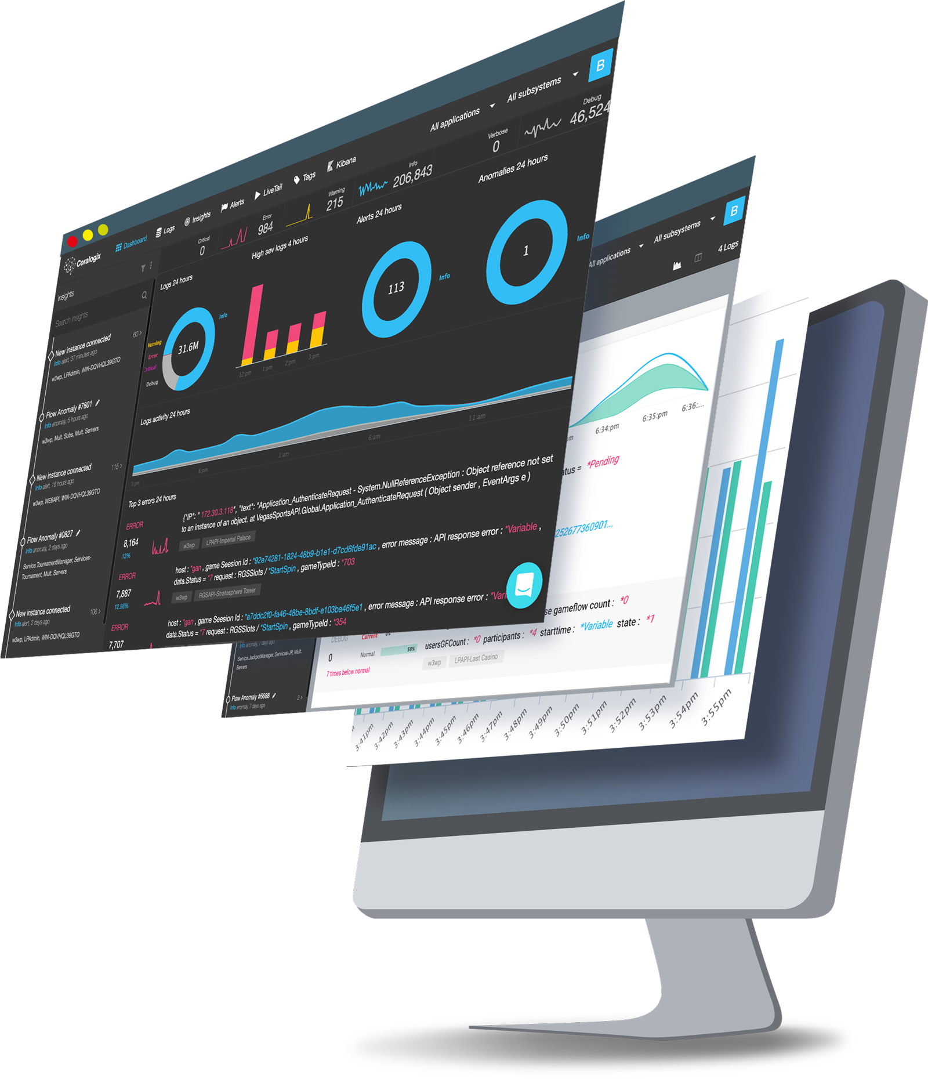
PRESENTOR
Ariel Assaraf
Co-founder & CEO
Security and availability measures

Slide 2
Coralogix secures your data throughout its journey
Coralogix runs on AWS north Europe, it's infrastructure is ,SOC,PCI,HIPAA compliant and is GDPR ready (data resides in AWS Ireland).
Coralogix's application is SOC2 type2 compliant (Security, Availability, Data integrity), PCI, HIPAA by BDO
All communication to and from Coralogix is done via SSL - Data sending, Interface, API’s.
Data in Coralogix is encrypted at rest
Each team is a separate index and URL, and gets a private key and ID for sending data and using the APIs, teams are completely separated and each team can connect his own IdP for SSO login.
Coralogix offers a centralized interface for whitening or blocking logs containing PII/sensitive data in case they are accidentally sent even before they are indexed or stored anywhere.

Slide 3
Coralogix secures your data throughout its journey
Coralogix offers unlimited S3 archive holding the original log copy, owned by the customer for compliance purposes.
Data is stored in different indexes for different teams/companies so that it is completely separated.
Coralogix uses Helmet on its API in order to protect it from various threats.
Coralogix's website and application are set behind a reverse proxy in order to not expose the web servers IP.
Coralogix production runs inside a sealed environment that can only be accessed by a VPN
Coralogix uses AWS security groups, auto backups, different availability zones, and is certified “Well architected” by AWS’s engineers for stability and security.
Coralogix Terms and Conditions, Privacy policy, and DPA are public on its website

